Slide 1

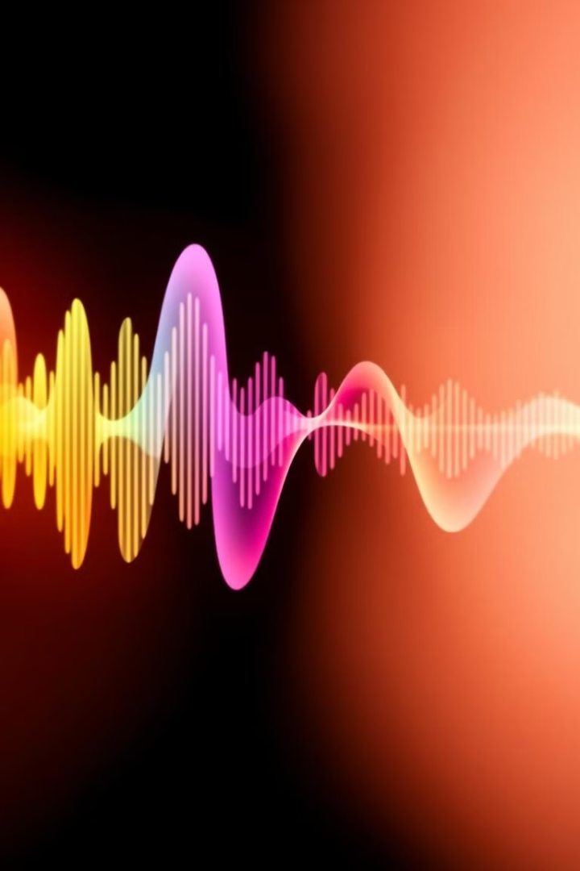

Vocal Separation Using Deep Learning
Advancing Accessible Audio Processing: Innovative Techniques for Vocal Separation
by Vasilis - Efraim Tsavalias

Slide 2

Introduction to Vocal Separation in Music
1
1. Isolating Vocals
2
2. Music Production
Vocal separation focuses on isolating the vocal elements from a musical recording, leaving the instrumental components intact.
This technique is widely used in music production for tasks such as remixing, vocal isolation, the creation of karaoke tracks and education.
3
3. Audio Accessibility
4
4. Research Focus
Vocal separation also plays a role in improving audio accessibility, making content more accessible for individuals with specific auditory preferences or impairments.
This presentation delves into the application of deep learning techniques for vocal separation, with a focus on the development and evaluation of a hybrid CNN-LSTM model.

Slide 3




Challenges in Vocal Separation
Noise and Interference
Unwanted sounds like background music or other instruments can obscure the target vocals. This can make it difficult to isolate the vocals accurately.
Frequency Overlap
Different instruments and voices often occupy similar frequency ranges, making it challenging to separate them without introducing artifacts.
Multiple Voice Sources
Separating vocals in recordings with multiple singers or speakers requires advanced techniques to distinguish individual voices.

Slide 4
Hybrid CNN-LSTM Deep Learning Approach
This research proposes a hybrid deep learning model to improve the accuracy and efficiency of vocal separation in music.
Feature Extraction
1
Convolutional Neural Networks (CNNs) are used to extract high-level features from the audio signal, capturing spatial and temporal patterns.
Temporal Modeling
2
Long Short-Term Memory (LSTM) networks are employed to model the temporal dependencies in the audio signal, enabling accurate prediction of vocal tracks.
Combined Prediction
3
The outputs of the CNN and LSTM are combined to generate a final prediction of the isolated vocal track.
The hybrid CNN-LSTM approach leverages the strengths of both architectures, resulting in improved performance for vocal separation.

Slide 5





Dataset Preparation and Preprocessing
Data Collection
A diverse dataset of music recordings was gathered, encompassing various genres, instruments, and vocal styles.
Data Augmentation
Techniques like time stretching, pitch shifting, and noise injection were employed to expand the dataset's diversity.
Data Splitting
The dataset was partitioned into training, validation, and testing sets, ensuring a balanced representation of different music genres and vocal characteristics.
Feature Extraction
Each audio signal was converted into a spectrogram, representing the time-frequency distribution of the signal.
Data Normalization
The spectrogram data was normalized to ensure consistency and improve model training efficiency.

Slide 6
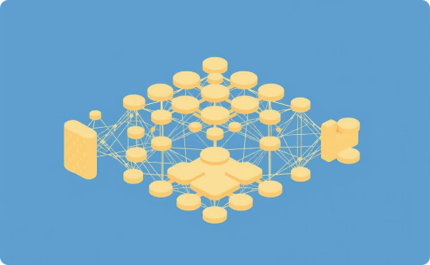
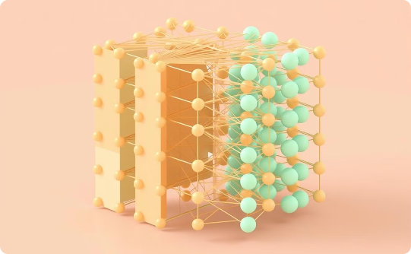
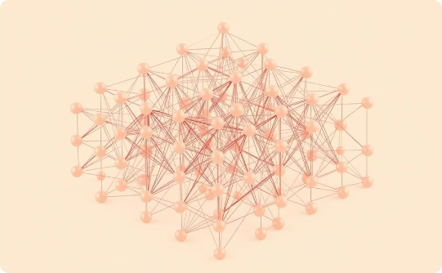
CNN Architecture for Feature Extraction
Convolutional Layers
Pooling Layers
Activation Functions
Convolutional layers learn local patterns and features in the audio signal. They use filters of different sizes to extract relevant information.
Pooling layers reduce the dimensionality of the feature maps, making the network more efficient and robust to small variations in the input.
Activation functions introduce non-linearity into the network, allowing it to learn complex relationships between features.

Slide 7
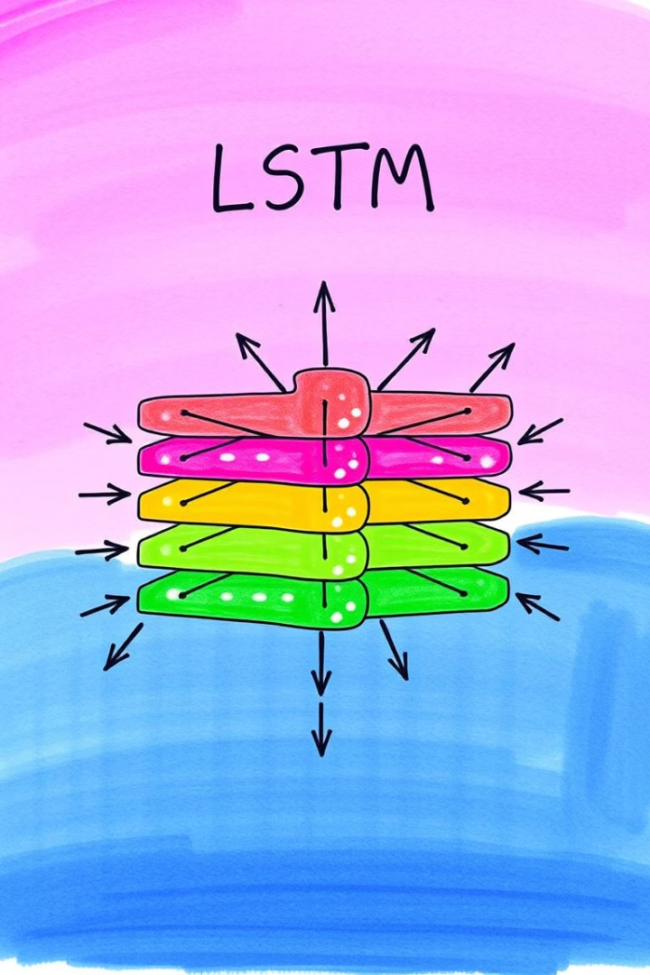
LSTM for Temporal Modeling
Long Short-Term Memory (LSTM) networks are a type of recurrent neural network (RNN) designed to handle sequential data, such as audio signals.
LSTMs excel at capturing long-range dependencies and context in time series data, making them well-suited for modeling the temporal dynamics of music signals.

Slide 8




Model Training and Optimization
Model Selection
1
Select the most suitable CNN-LSTM architecture for the task. In this study, we employ a hybrid approach known as "MaskInference."
Hyperparameter Tuning
2
Optimize learning rate, batch size, and other hyperparameters by using Optuna framework.
3
Regularization
Prevent overfitting by using techniques like dropout or L2 regularization.
4
Early Stopping
Monitor validation loss and stop training when performance plateaus.
This involves fine-tuning the model parameters to achieve optimal performance.
We use techniques like early stopping, cross-validation, and optuna trials to find the best configuration.

Slide 9

Evaluation Metrics
Signal-to-Interference Ratio (SIR):
Measures the model's ability to minimize interference from non-vocal elements in the separated audio.
Signal-to-Artifact Ratio (SAR):
Evaluates the extent to which the model introduces unwanted artifacts during vocal separation.
Signal-to-Distortion Ratio (SDR):
Assesses the overall quality of the separated vocals by quantifying the distortion present in the output.

Slide 10

Results and Performance Analysis
The proposed CNN-LSTM model achieved impressive results in vocal separation.
Metric
Training / Validation
Testing
SDR
1.76 dB
-inf dB
SIR
-0.37 dB
-inf dB
SAR
1.76 dB
-inf dB
loss
0.60
0.61

Slide 11

Model Limitations
In addition to the specific errors observed, there are broader limitations inherent to the model and the overall approach used in this study:
Generalization to Diverse Audio Sources: The model, trained on the MUSDB18 dataset, may struggle to generalize to entirely new genres, recording environments, or vocal styles, limiting its effectiveness in diverse real-world applications.
Handling of Highly Overlapping Sources: The model faces challenges in separating vocals from background music when they overlap significantly in frequency and time, indicating a need for more advanced separation techniques.
Trade-offs Between Model Complexity and Deployment Efficiency: Dynamic quantization improved deployment efficiency by reducing model size and resource usage, but it also led to potential losses in separation quality due to reduced precision, highlighting the trade-off between performance and efficiency in real-world applications.

Slide 12

Comparison to State-of-the-Art Methods
Performance Comparison
While our hybrid CNN-LSTM model demonstrates inferior results, recent advancements in vocal separation have led to the development of models like Demucs, developed by Facebook, and newer U-Net architectures that often achieve superior performance. These models, however, may come at the cost of increased computational complexity and efficiency compared to our approach.
For instance, Demucs, a deep learning model specifically designed for high-quality music source separation, employs a multi-stage convolutional network with an encoder-decoder architecture. This architecture allows for the extraction of rich audio features and the reconstruction of separated audio signals with high fidelity. However, Demucs often requires significant computational resources for training and inference, making it less suitable for real-time or resource-constrained applications.
Similarly, U-Net-based architectures, commonly used in image segmentation and other tasks, have been adapted for vocal separation. These models leverage skip connections and dilated convolutions to capture multi-scale features and effectively separate overlapping audio sources. While U-Nets have demonstrated impressive performance, they may also exhibit high computational complexity, particularly for large datasets and complex audio signals.

Slide 13

Potential Areas for Improvement & Future Directions
Data Augmentation and Enhanced Training Datasets
Advanced Model Architectures:
Explore advanced architectures, such as attention mechanisms or sophisticated separation algorithms, to improve the model's ability to handle complex, overlapping audio sources.
Enhance the model's generalization by augmenting training data with diverse audio samples, including various genres, vocal styles, and recording environments, and by adding more challenging vocal/non-vocal mixtures.
Refinement of Post-Processing Techniques:
Subjective Evaluation
Objective evaluation metrics do not fully capture the subjective quality of separated vocals. Human perception and listening tests are essential. To address this, conducting MUSHRA tests or similar listening evaluations is essential for a more comprehensive assessment of audio quality.
Focus on improving post-processing techniques to minimize artifacts and enhance the quality of separated vocals, potentially through advanced filtering or custom algorithms.

Slide 14

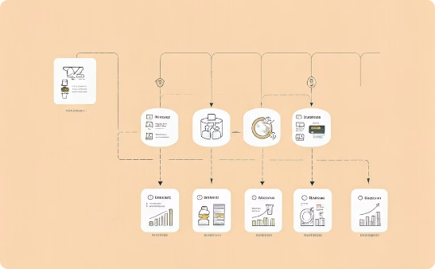
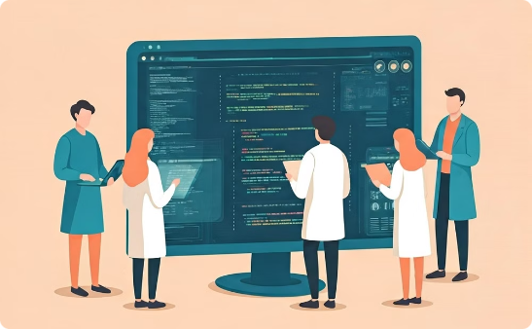
Conclusion and Key Takeaways
Promoting Open-Source Accessibility
Enhancing Reproducibility
Foundation for Future Improvements
This study developed a hybrid CNN-LSTM model for vocal separation, emphasizing an open-source, accessible pipeline. While not flawless in isolating vocals, it provides a valuable, reproducible guideline for future research.
The research's main contribution is creating an open-source pipeline that others can replicate and extend. It prioritizes transparency and accessibility, offering a structured approach over mere performance.
While acknowledging the model's limitations, this study lays the groundwork for future enhancements. It encourages exploration of advanced architectures and diverse datasets, ensuring future research can build on this transparent framework.

Slide 15
Applications and Real-World Implications
How can vocal separation be used to personalize music listening?
How can vocal separation enhance educational and therapeutic applications?
Vocal separation allows for tailored music listening. Users can isolate vocals for karaoke, instrument practice, or creating custom mixes.
Vocal separation can be used in educational settings to isolate and analyze specific elements of a song. In therapeutic contexts, it can help create customized audio experiences for relaxation or cognitive therapies.
How can vocal separation be used in music production?
What are some examples of interactive music systems that use vocal separation?
Producers and remixers can leverage vocal separation to create unique soundscapes by manipulating individual tracks.
Along with Facebook's Demucs, Splitter, a transformer, is often used in live performances and DJ sets, where real-time control over vocal and instrumental tracks allows for dynamic and engaging audience experiences.

Slide 16



Thank you!
vas.tsavv@gmail.com
vasilistsavalias

Slide 17
References
To condense all these citations into a single slide, you can group them into categories and present them in a simplified manner. Here's a suggested approach:
Selected Bibliography
Vocal Separation and Audio Processing
Z. Rafii et al., "An overview of lead and accompaniment separation in music," 2018. [Online]. Available: Semantic Scholar.
P. Papantonakis, "Singing voice separation using waveform-level deep neural networks," 2022. [Online]. Available: NTUA.
Deep Learning and Machine Learning Techniques
D. Stoller et al., "Wave-U-Net: A multi-scale neural network for end-to-end audio source separation," 2018. [Online]. Available: Arxiv.
S. Pegg et al., "Efficient speech separation with audio-visual attention," 2023. [Online]. Available: Arxiv.
D. Camp, "Types of machine learning," 2023. [Online]. Available: DatabaseCamp.
Tools and Applications
AudioSourceRE, "Demix Pro Audio Separation Software," 2024. [Online]. Available: AudioSourceRE.
FasterCapital, "Recurrent Neural Networks," 2024. [Online]. Available: FasterCapital.
Evaluation Metrics
E. Gusó et al., "On loss functions and evaluation metrics for music source separation," 2022. [Online]. Available: Arxiv.
M. Cartwright et al., "Fast and easy crowdsourced perceptual audio evaluation," 2016. [Online]. Available: IEEE.
For a comprehensive exploration of the methodologies, experiments, and detailed findings, I encourage you to refer to the full thesis document. All aspects of this research, including in-depth analyses and additional references, are thoroughly covered there

